Slide 1
Gfwc-MFWC 2018 TOP TEN
COMMUNITY SERVICE PROJECTS , special projects and ADVANCEMENT AREAS

Slide 2
TOP TEN ARTS COMMUNITY SERVICE
Cosmopolitan Club of Petal revived their city’s non-functioning arts council. Some members served as officers along with other members from the community. Club members organized art shows and art markets at which they set up and took down tents. They sponsored and participated in the Petal Community Choir and the Petal Chamber of Commerce tree lightening ceremony. They also presented a scholarship.
Fine Arts Club of Bruce and Twentieth Century Club of Bruce sponsored a countywide school production of Beauty and the Beast. They paid the cost of licensure, purchased ads, and rented costumes. They volunteered time during auditions and practices. Three county schools participated. The clubs investigated $1,065 in this project.
Florentine Evening Club sponsored a Christmas Tour of Homes. They selected homes to be visited, made photographs of home and published them in the local paper. They invited a high school student to wear a snowman suit at the Tour of Homes reception they hosted at the community center. Members of the community enjoyed the creativity of the event and opportunity to socialize.
Decatur Woman’s Progressive Club has “Art Minutes” at each club meeting. The art chairman or another club member reports on a specific art project members completed or a special community art opportunity. One report was about members helping developmentally challenged students make Christmas ornaments and paint a worm to illustrate as story.
Quitman Woman’s Club has joined as a sponsor of the Mississippi Arts and Entertainment Experience (The MAX) in Meridian, Ms. the MAX is a revolutionary museum honoring Mississippi’s legends and inspiring tomorrow is artists. The MAX provides educational opportunities for youth and families and create a sense of pride about Mississippi’s people. The club worked 215 hours and donated $1500.
GFWC Mississippi Arts Chairmen annually promote a youth arts contest in local schools. These art displays are judged and awarded at district conventions and first place winners are carried to state conventions for final awards. Club Arts Chairmen give guidelines to teachers and the participants awarded first place at district receive $5.00 and a blue ribbon. State first place convention winners are awarded blue ribbons. Thirteen clubs for GFWC Mississippi sponsored youth art contest in local schools.
GFWC Mississippi display and report participation in arts and crafts District Conventions. Exhibits included quilting crochet, painting, fine sewing, wearable jewelry, weaving and other crafts. There are specific guidelines for craft entry reported in the club manual for entering the contest. First place award winners are place for additional judging at GFWC Mississippi State Convention in April.
Purvis Woman’s Club sponsored community events in the local park. Admission is free and club and local businesses furnish refreshments. They showed the movies Rudy and Elf and presented Blues Music by Johnny Rawls.
Four clubs supported the “Express Yourself Art Project” at the TK Martin Center, an art center for significantly handicapped individuals. The club donated meals to be auctioned at their meeting to raise funds for the center. Other clubs donated funds and bought paintings. Donations totaled $6618.
GFWC Twentieth Century Club of Ackerman actively participated in the Choctaw County Distinguished Young Woman Program. Club members prepared the program book made decorations for “Fiesta” themed program, including 100 tissue flowers. They hosted a trunk show and featured a program for 6 the grade girls to learn about the DTW program. This group called the “The Shining Stars, had as a motto “Be Your Best Self.” Club members spent $2992 and make in-kind contributions of $7494 and 6,000 hours.

Slide 3
Top ten conservation community service

Slide 4
Top ten community service education
1. HOBY CLEW Project, GFWC-MFWC Juniorette Diamonds of Picayune: After receiving HOBY brochures, Juniorette Diamonds contacted the national HOBY director about sponsoring CLEW, a leadership workshop for freshman students at the local high school. In their view, this was an opportunity to involve more students in HOBY, since only one student is selected in their rising junior year. It is the first CLEW in Mississippi. Nine Juniorettes arranged speakers and wrote special invitations to freshman teachers to invite up to 25 students. Principals, state representatives (including Steven Palazzo, US Representative, Mississippi), the Picayune chancery clerk, a Navy commander, and “Fortune 500” Corporate leaders were engaged as speakers for the event. Juniorettes incurred all expenses, paying for invitations, packets, continental breakfast items, snacks, and a luncheon. They decorated, served, introduced guests and introduced speakers. 24 freshman students attended this all-day workshop, and as a result of the event’s success, Juniorette Diamonds were asked to host other civic events. 9 members, 90 hours, $846.00 in-kind
2. “BeYOUtiful” Charity Event, Florentine Evening Club: After a successful Education Week project in which school-requested supplies were collected and distributed to four local schools in Florence, members discovered in discussions with local school counsellors that middle and high school girls were not prepared for feminine hygiene needs. To raise awareness, club members held a “BeYOUtiful” charity event in December that included a dinner and silent auction (items donated by individuals and local businesses). Attendees were asked to contribute feminine products. $1350.00 was raised, and products were distributed to three adjacent city school systems as well as Florence Middle and High School. 21 members, 50 hours, $1350.00 raised (money raised reported under Fundraising)
3. Sandra Cain Memorial Scholarship for Non-Traditional Students, GFWC-MFWC Fine Arts Club of Bruce: This club-sponsored scholarship program was organized to award scholarships to students who choose alternate routes to continuing their education. A $300.00 scholarship was awarded to a non-traditional student pursuing a degree in Respiratory Therapy. Most club scholarship programs are open to high school students, but this project reaches out to older students in the community. 36 members, $300.00 donated
4. “Treasures for Teachers”, Enterprise Women’s Club: The nine members of Enterprise Women’s Club, responding to educators in local schools, sponsored a community drive to collect teacher-identified needed items for children in the Enterprise school district. “Treasures for Teachers” drop boxes were set up in local churches, businesses, and the town bank. Collected items were divided and distributed to Enterprise Elementary, Middle and High Schools. 9 members, 17.5 hours, $147.00 in-kind
5. Distinguished Young Woman Program, Ackerman 20th Century Club: Ackerman 20th Century Club sponsors the Choctaw County DYW program each year. The central focus of the program is to recognize and award excellence in academics. Its mission is to provide scholarship opportunities to outstanding college-bound high school girls. Club members raised $9000.00 soliciting local businesses, and disbursed the scholarships to the winner and five alternates upon entering college in the fall. It is the largest DYW community scholarship program in Mississippi. Members also mentor the girls and offer guidance and support as they prepare for the program. 19 members, 140 hours, $9000 donated
. Education Hints, Raleigh Women’s Club: Nine members researched and reviewed data on local and national literacy levels and other education topics to prepare “Education Hints” for each club meeting. Hints were typed, copied, distributed, and discussed at the meetings, resulting in raised awareness of such topics as dropout rates and autism. 9 members, 156 hours
7. Southeast Mississippi Children’s Concert, Cosmopolitan Club of Petal: Cosmopolitan Club of Petal, in partnership with the Petal Education Foundation, the Coleman Center for Families and Children and other local businesses sponsors the Southeast Mississippi Children’s Concert. Over 1000 pre-K children from Petal and Head Starts and preschools in surrounding cities and towns take part in the interactive program. Professional children’s music educators, such as this year’s Jack Hartman, encourage the children to sing, move, and reinforce additional educational concepts such as counting, spelling, and simplified critical thinking and problem solving. Club members also assist with ticket sales, ticket taking, meeting student groups at their buses and leading them to their seats in the auditorium. 15 members, 4 hours, $500.00 donated.
8. High School Honors Reception, Quitman Women’s Club: Graduating honors and high honors senior students were celebrated, along with their families and those of recipients of Quitman Women’s Club scholarships. This reception, in its fourth year, is growing in size each year, with 180 attendees (34 students honored). The school district Board, Superintendent of Schools, high school administration, and members of the senior faculty were also invited to attend. The reception is a “cut-cake” reception with each of the nineteen members donating a home-made cake. There are no other awards receptions for honor students in Quitman. Clubwomen secured and decorated the venue, and prepared invitations, etc. for the event. 19 members, 475 hours, $250.00 donated, $600.00 in-kind.
9. Seven Grand Initiatives Participation, 20th Century Club of Bruce: Recognizing the importance of reading at an early age and participating in President Brock’s Seven Grand Initiatives, Twentieth Century Club of Bruce bought 40 Dr. Seuss books and presented a book to each K4 student in Bruce to take home to share and read with their parents. 14 members, 1 hour, $85.00 in-kind
10. ESO Online Reading Group, Batesville Junior Women’s League: Five of the eight members of Batesville Junior Women’s League participated in reading and book discussions throughout the year online through their BJWL ESO Reading Group. Members also promoted ESO reading by inviting and engaging others in the group. In addition to the club members, thirteen other women, including members from other clubs are participating. Members kept track of reading progress on “Goodreads” by keeping a “read” list. All eight members are working toward pledge level or star level in ESO. 5 members, 15 hours

Slide 5
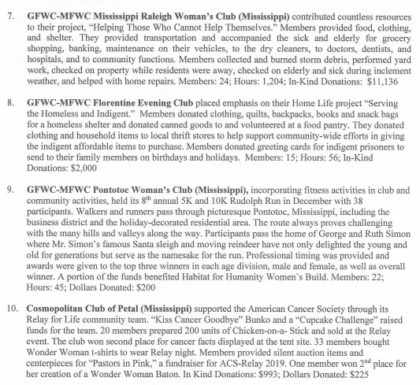
Top ten community service awards home life

Slide 6
Top ten community service international outreach
GFWC-MFWC Fine Arts Club of Bruce (MS) also sold two different whimsical
t-shirts featuring Holstein cows to raise funds to purchase a cow and bring awareness to Heifer International: “Hanging with my Heifers” and “Have a Mooey Christmas” garnered much attention and proceeds of over $300 was donated to the cause.
The Civic Woman’s Club of Picayune (MS) donated fabric, sewed and stuffed 79 Operation Smile dolls.
The Women’s Club of Gulfport (MS) raises money for Heifer International by collecting loose change for “Pennies for the Pig” to be donated to Heifer International. They also donated to the International Milk Money Program.
The Women’s Club of Gulfport (MS) raises money for Operation Smile at each general meeting when they offer “Brag Time”. For a donation to the “doggie bank”, members may brag about anything in their lives.
The GFWC-MFWC Florentine Evening Club (MS) provided a luncheon for International Students at Mississippi College and a Thanksgiving Luncheon for International Students at Millsaps College.
GFWC Mississippi Ackerman 20th Century Club (MS) members were challenged to contribute ½ of their monthly water bill to help fund a water well in a third world country.
GFWC-MFWC Batesville Woman’s Club (MS) donated plastic bags and empty egg cartons to be filled with unpackaged wholesale eggs at their local food pantry.
GFWC-MFWC Eupora 20th Century Club (MS) and the Civic Woman’s Club of Picayune (MS) purchased material (120 kits) and made reusable sanitary products for women in third world areas. They also prepared health care kits and Eupora made 300 headbands for their project.
The GFWC-MFWC Fine Arts Club of Bruce (MS) constructed, decorated and road or walked with a Christmas Parade float which was designed to promote the Heifer International Partnership: Feeding the Hungry Around the World. The club’s International Outreach Chairman ordered brochures and pins from Heifer International and filled bags to hand out the information regarding the project along the parade route as well as bookmarks and Cow tail candies.

Slide 7
Gfwc special projects top ten public issues

Slide 8
Communications public relations

Slide 9
Top ten Gfwc leadership

Slide 10
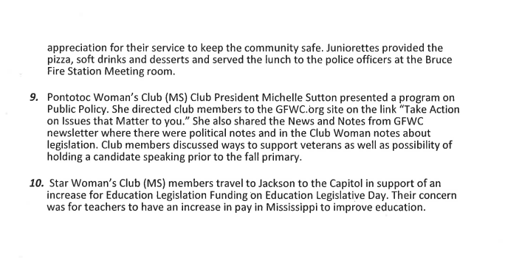
Top ten gfwc legislation pubic policy

Slide 11
Top ten gfwc membership

Slide 12
Top ten gfwc fundraising

Slide 13
Top ten gfwc women history resource center

Slide 14
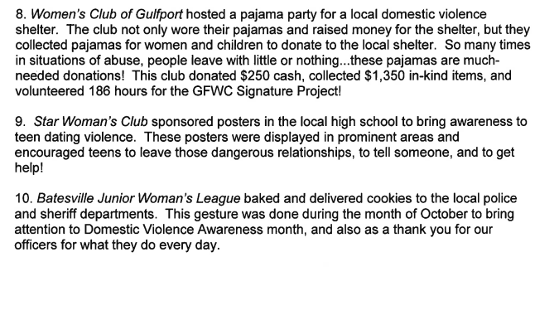
Top ten gfwc domestic violence awareness

Slide 15
Top ten gfwc advocates for children

